Slide 1
Analiza impedansnog kardiograma za prepoznavanje besa
Marko Lazarevski 2020/0045
13E054KLIN
Jul 2024, Beograd

Slide 2
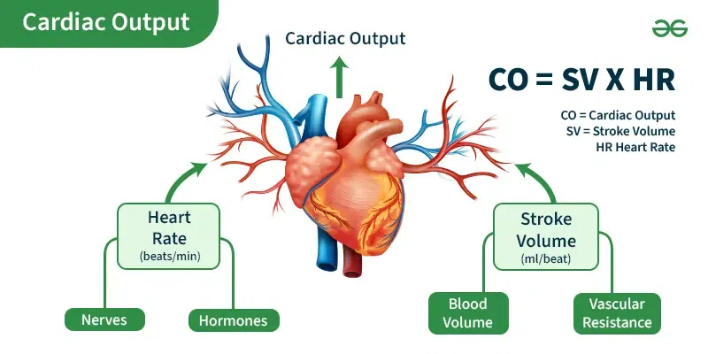

Slide 3
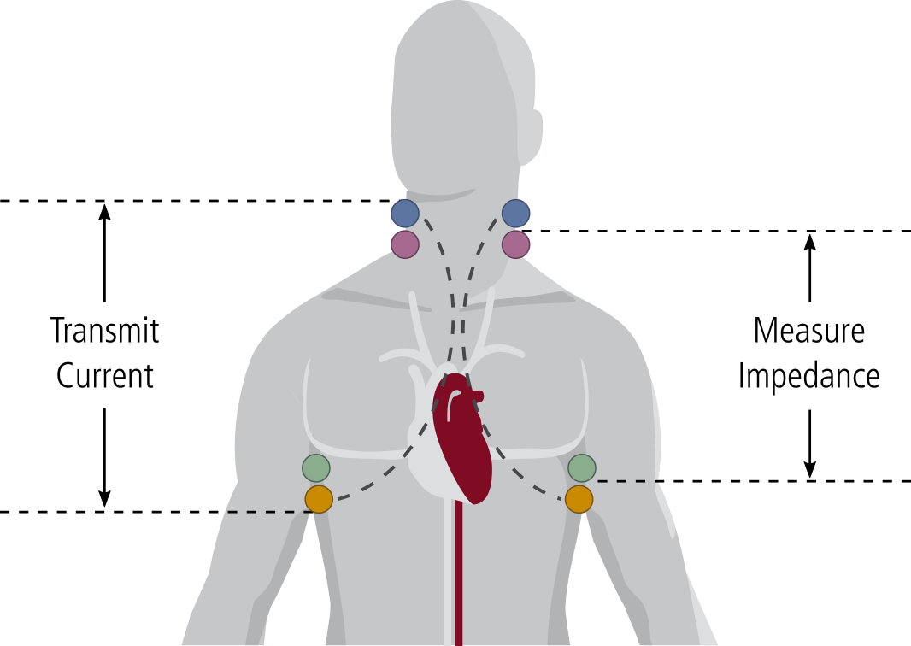

Istorija
1966. NASA Kubicek
1980.Bernstein i Sramek

Slide 4
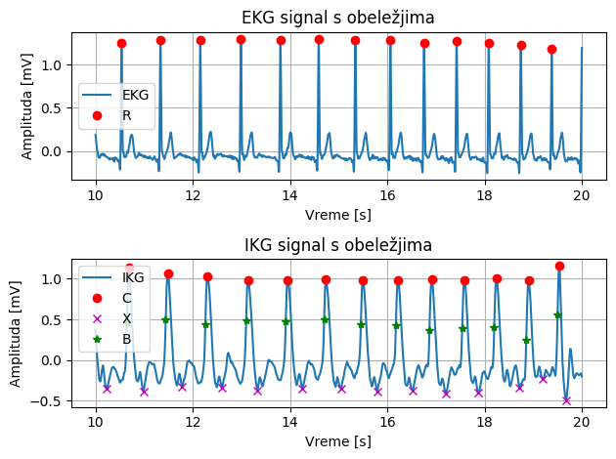
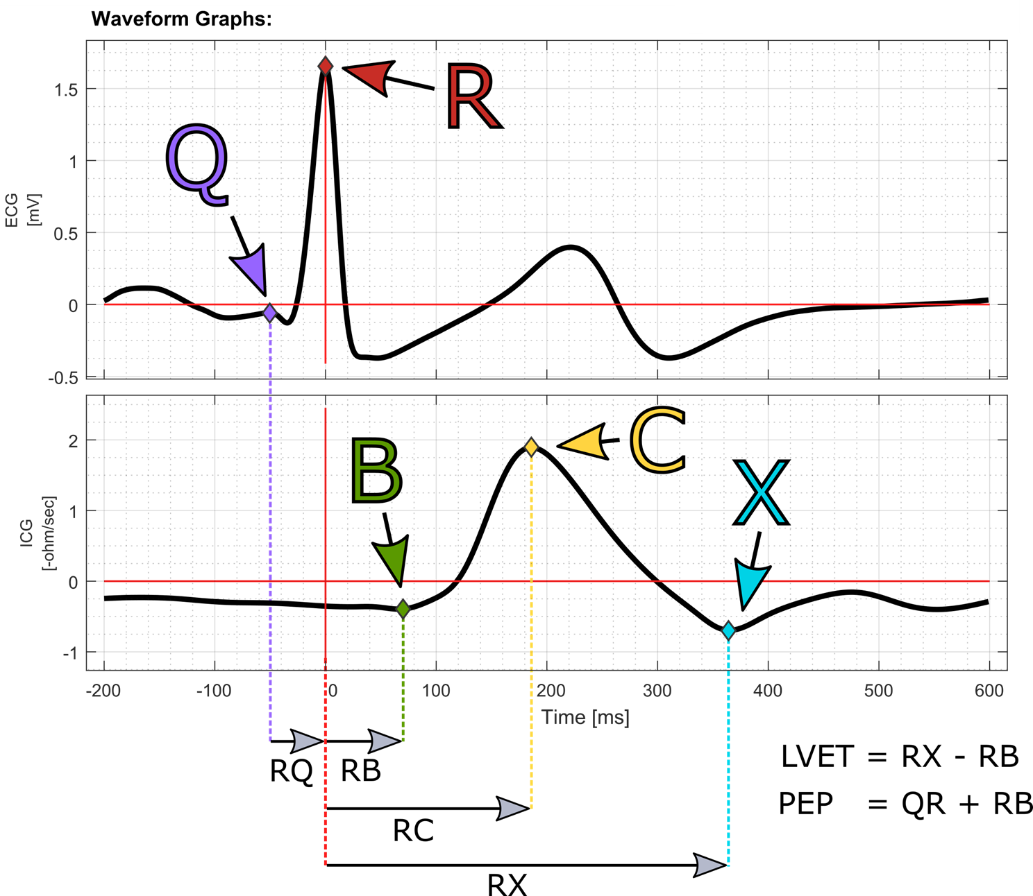
EKG i IKG talasni oblici

Slide 5
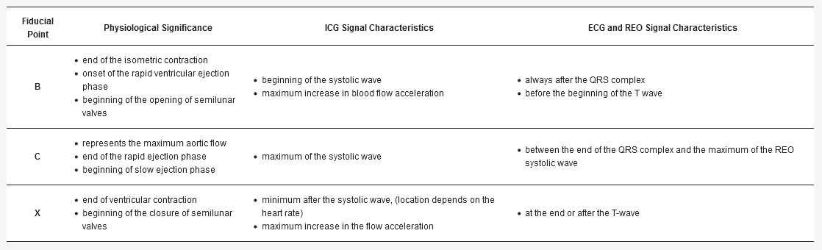

Slide 6
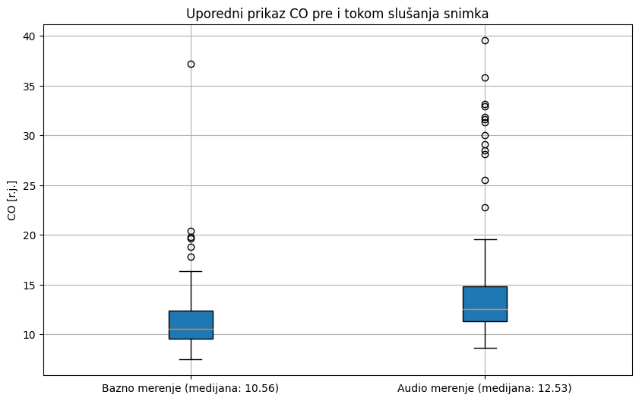
Rezultati
4 od 5 ispitanika ima veću medijanu CO
3 od 5 ima veću standardnu devijaciju CO

Slide 7
Reference
https://www.geeksforgeeks.org/cardiac-output-definition/
https://www.medis.company/en/methods/impedance-cardiography
https://www.nasa.gov/history/symbols-of-nasa/
Karpiel, I., Richter-Laskowska, M., Feige, D., Gacek, A., & Sobotnicki, A. (2022). An Effective Method of Detecting Characteristic Points of Impedance Cardiogram Verified in the Clinical Pilot Study. Sensors (Basel, Switzerland), 22(24), 9872. https://doi.org/10.3390/s22249872
https://physiodatatoolbox.leidenuniv.nl/docs/user-guide/physioanalyzer-modules/icg-ensemble-module.html

